Slide 1
Database Systems
prof., dr., Vladimir Dimitrov

Slide 2
Representing Data Elements
Next material relates the block model of secondary storage that we covered to the requirements of a DBMS. We begin by looking at the way that relations or sets of objects are represented in secondary storage.
Attributes need to be represented by fixed- or variable-length sequences of bytes, called “fields.”
Fields, in turn, are put together in fixed- or variable-length collections called “records,” which correspond to tuples or objects.
Records need to be stored in physical blocks. Various data structures are useful, especially if blocks of records need to be reorganized when the database is modified.
A collection of records that forms a relation or the extent of a class is stored as a collection of blocks, called a file. (The database notion of a “file” is somewhat more general than the “file” in an operating system. While a database file could be an unstructured stream of bytes, it is more common the file to consist of a collection of blocks organized in some useful way, with indexes or other specialized access methods. We discuss these organizations later.) To support efficient querying and modification of these collections, we put one of a number of “index” structures on the file.

Slide 3
Data Elements and Fields
We shall begin by looking at the representation of the most basic data elements: the values of attributes found in relational or object-oriented database systems. These are represented by “fields.” Subsequently, we shall see how fields are put together to form the larger elements of a storage system: records, blocks, and files.

Slide 4
Representing Relational Database Elements
Suppose we have declared a relation in an SQL system, by a CREATE TABLE statement, which repeats the definition in figure. The DBMS has the job of representing and storing the relation described by this declaration. Since a relation is a set of tuples, and tuples are similar to records or “structs” (the C or C++ term), we may imagine that each tuple will be stored on disk as a record. The record will occupy (part of) some disk block, and within the record there will be one field for every attribute of the relation.
CREATE TABLE MovieStar(
name CHAR(30) PRIMARY KEY,
address VARCHAR(255),
gender CBAR(1),
birthdate DATE
);
An SQL table declaration

Slide 5
Representing Relational Database Elements
While the general idea appears simple, the “devil is in the details,” and we shall have to discuss a number of issues:
How do we represent SQL datatypes as fields?
How do we represent tuples as records?
How do we represent collections of records or tuples in blocks of memory?
How do we represent and store relations as collections of blocks?
How do we cope with record sizes that may be different for different tuples or that do not divide the block size evenly, or both?
What happens if the size of a record changes because some field is updated? How do we find space within its block, especially when the record grows?
Further, we need to consider how to represent certain kinds of data that are found in modern object-relational or object-oriented systems, such as object identifiers (or other pointers to records) and “blobs” (binary, large objects, such as a 2-gigabyte MPEG video).

Slide 6
Representing Objects
To a first approximation, an object is a tuple, and its fields or “instance variables” are attributes. Likewise, tuples in object-relational systems resemble tuples in ordinary, relational systems. However, there are two important extensions beyond what we discussed:
Objects can have methods or special-purpose functions associated with them. The code for these functions is part of the schema for a class of objects.
Objects may have an object identifier (OlD), which is an address in some global address space that refers uniquely to that object. Moreover, objects can have relationships to other objects, and these relationships are represented by pointers or lists of pointers.
Methods are generally stored with the schema, since they properly belong to the database as a whole, rather than any particular object. However, to access methods, the record for an object needs to have a field that indicates what class it belongs to.
Techniques for representing addresses, whether object ID’s or references to other objects, are discussed later. Relationships that are part of an object, as are permitted in ODL, also require care in storage. Since we don’t know how many related objects there can be (at least not in the case of a many-many relationship or the “many” side of a many-one relationship), we must represent the relationship by a “variable-length record”.

Slide 7
Representing Data Elements
Let us begin by considering how the principal SQL datatypes are represented as fields of a record. Ultimately, all data is represented as a sequence of bytes. For example, an attribute of type INTEGER is normally represented by two or four bytes, and an attribute of type FLOAT is normally represented by four or eight bytes. The integers and real numbers are represented by bit strings that are specially interpreted by the machine’s hardware so the usual arithmetic operations can be performed on them.

Slide 8
A Note on Terminology
Depending on whether you have experience with file systems, conventional programming languages like C, with relational database languages (SQL in particular), or object-oriented languages (e.g., Smalltalk, C++, or the object-oriented database language OQL), you may know different terms for essentially the same concepts. The following table summarizes the correspondence, although there are some differences, e.g., a class can have methods; a relation cannot.
We shall tend to use file-system terms fields and records unless we are referring to specific uses of these concepts in database applications. In the latter case we shall use relational and/or object-oriented terms.

Slide 9
A Note on Terminology
 | Data Element | Record | Collection
Files | field | record | file
C | field | struct | array, file
SQL | attribute | tuple | Relation
OQL | attribute, relationship | object | extent (of a class)

Slide 10
Fixed-Length Character Strings
The simplest kind of character strings o represent are those described by the SQL type CHAR(n). These are fixed-length character strings of length n. The field for an attribute with this type is an array of n bytes. Should the value for this attribute be a string of length shorter than n, then the array is filled out with a special pad character, whose 8-bit code is not one of the legal characters for SQL strings.

Slide 11
Example
If an attribute A were declared to have type CHAR(5), then the field corresponding to A in all tuples is an array of five characters. If in one tuple the component for attribute A were ‘cat’, then the value of the array would be:
cat±±
Here, I is the “pad” character, which occupies the fourth and fifth bytes of the array. Note that the quote marks, which are needed to indicate a character string in SQL programs, are not stored with the value of the string.

Slide 12
Variable-Length Character Strings
Sometimes the values in a column of a relation are character strings whose length may vary widely. The SQL type VARCHAR(n) is often used as the type of such a column. However, there is an intended implementation of attributes declared this way, in which n + 1 bytes are dedicated to the value of the string regardless of how long it is. Thus, the SQL VARCHAR type actually represents fields of fixed length, although its value has a length that varies. We shall examine character strings whose representation’s length varies later.

Slide 13
Variable-Length Character Strings
There are two common representations for VARCHAR strings:
Length plus content. We allocate an array of n + 1 bytes. The first byte holds, as an 8-bit integer, the number of bytes in the string. The string cannot exceed n characters, and n itself cannot exceed 255, or we shall not be able to represent the length in a single byte. (Of course we could use a scheme in which two or more bytes are dedicated to the length. )The second and subsequent bytes hold the characters of the string. Any bytes of the array that are not used, because the string is shorter than the maximum possible, are ignored. These bytes cannot possibly be construed as part of the value, because the first byte tells us when the string ends.
Null-terminated string. Again allocate an array of n +1 bytes for the value of the string. Fill this array with the characters of the string, followed by a null character, which is not one of the legal characters that can appear in character strings. As with the first method, unused positions of the array cannot be construed as part of the value; here the null terminator warns us not to look further, and also makes the representation of VARCHAR strings compatible with that of character strings in C.

Slide 14
Example
12.2: Suppose attribute A is declared VARCHAR(t0). We allocate an array of 11 characters in each tuple’s record for the value of A. Suppose ‘cat’ is the string to represent. Then in method 1, we would put 3 in the first byte to represent the length of the string, and the next three characters would be the string itself. The final seven positions are irrelevant. Thus, the value appears as:
3cat
Note that the “3” is the 8-bit integer 3, i.e., 00000011, not the character ‘3’.
In the second method, we fill the first three positions with the string; the fourth is the null character (for which we use the symbol I, as we did for the “pad” character), and the remaining seven positions are irrelevant. Thus,
cat±
is the representation of ‘cat’ as a null-terminated string.

Slide 15
Dates and Times
A date is usually represented as a fixed-length character string, as discussed. Thus, a date can be represented just as we would represent any other fixed-length character string. Times may similarly be represented as if they were character strings. However, the SQL standard also allows a value of type TIME to include fractions of a second. Since such strings are of arbitrary length, we have two choices:
The system can put a limit on the precision of times, and times can then be stored as if they were type VARCHAR(n), where n is the greatest length a time can have: 9 plus the number of fractional digits allowed in seconds.
Times can be stored as true variable-length values and dealt with as discussed.

Slide 16
Bits
A sequence of bits — that is, data described in SQL by the type BIT(n) — can be packed eight to a byte. If n is not divisible by 8, then we are best off ignoring the unused bits of the last byte. For instance, the bit sequence 010111110011 might be represented by 01011111 as the first byte and 00110000 as the second; the final four 0’s are not part of any field. As a special case, we can represent a boolean value, that is, a single bit, as 10000000 for true and 00000000 for false. However, it may in some contexts be easier to test a boolean if we make the distinction appear in all bits; i.e., use 11111111 for true and 00000000 for false.

Slide 17
Enumerated Types
Sometimes it is useful to have an attribute whose values take on a small, fixed set of values. These values are given symbolic names, and the type consisting of all those names is an enumerated type. Common examples of enumerated types are days of the week, e.g., {SUN, MON, TUE, WED, THU, FRI, SAT}, or a set of colors, e.g., {RED, GREEN, BLUE, YELLOW}.
We can represent the values of an enumerated type by integer codes, using only as many bytes as needed. For instance, we could represent RED by 0, GREEN by 1, BLUE by 2, and YELLOW by 3. These integers can each be represented by two bits, 00, 01, 10, and 11, respectively. It is more convenient, however, to use full bytes for representing integers chosen from a small set. For example, YELLOW is represented by the integer 3, which is 00000011 as an eight-bit byte. Any enumerated type with up to 256 values can be represented by a single byte. If the enumerated type has up to 216 values, a short integer of two bytes will suffice, and so on.

Slide 18
Packing Fields Into a Single Byte
One may be tempted to take advantage of fields that have small enumerated types or that are boolean-valued, to pack several fields into a single byte. For instance, if we had three fields that were a boolean, a day of the week, and one of four colors, respectively, we could use one bit for the first, 3 bits for the second, and two bits for the third, put them all in a single byte and still have two bits left over. There is no impediment to doing so, but it makes retrieval of values from one of the fields or the writing of new values for one of the fields more complex and error-prone. Such packing of fields used to be more important when storage space was more expensive.
Today, we do not advise it in common situations.

Slide 19
Records
We shall now begin the discussion of how fields are grouped together into records. The study continues later, where we look at variable-length fields and records.
In general, each type of record used by a database system must have a schema, which is stored by the database. The schema includes the names and data types of fields in the record, and their offsets within the record. The schema is consulted when it is necessary to access components of the record.

Slide 20
Building Fixed-Length Records
Tuples are represented by records consisting of the sorts of fields discussed. The simplest situation occurs when all the fields of the record have a fixed length. We may then concatenate the fields to form the record.
Some machines allow more efficient reading and writing of data that begins at a byte of main memory whose address is a multiple of 4 (or 8 if the machine has a 64-bit processor). Certain types of data, such as integers, may be absolutely required to begin at an address that is a multiple of 4, while others, such as double-precision reals, may need to begin with a multiple of 8.

Slide 21
Example
Consider the declaration of the MovieStar relation. There are four fields:
name, a 30-byte string of characters.
address, of type VARCHAR(255). This field will be represented by 256 bytes, using the schema discussed in Example 12.2.
gender, a single byte, which we suppose will always hold either the character ‘F’ or the character ‘M’.
birthdate, of type DATE. We shall assume that the 10-byte SQL representation of dates is used for this field.
Thus, a record of type MovieStar takes 30 + 256 + 1 + 10 = 297 bytes. It looks as suggested in figure. We have indicated the offset of each field, which is the number of bytes from the beginning of the record at which the field itself begins. Thus, field name begins at offset 0; address begins at offset 30, gender at 286, and birthdate at offset 287.

Slide 22
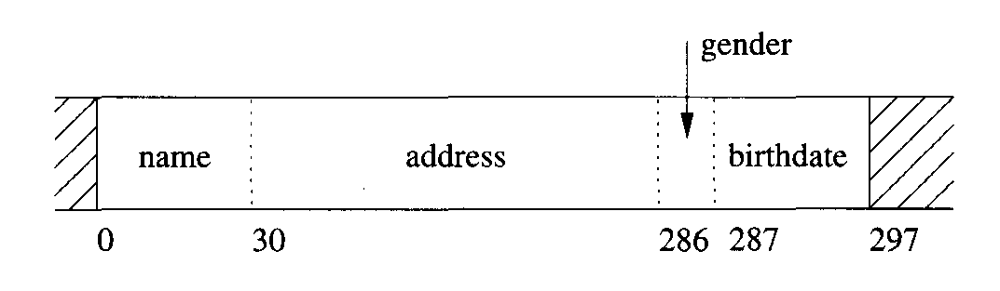
A MovieStar record

Slide 23
Building Fixed-Length Records
While the tuples of a relation are stored on disk and not in main memory, we have to be aware of this issue. The reason is that when we read a block from disk to main memory, the first byte of the block will surely be placed at a memory address that is a multiple of 4, and in fact will be a multiple of some high power of 2, such as 212 if blocks and pages have length 4096 = 212. Requirements that certain fields be loaded into a main-memory position whose first byte address is a multiple of 4 or 8 thus translate into the requirement that those fields have an offset within their block that has the same divisor.
For simplicity, let us assume that the only requirement on data is that fields start at a main-memory byte whose address is a multiple of 4. Then it is sufficient that
Each record start at a byte within its block that is a multiple of 4, and
All fields within the record start at a byte that is offset from the beginning of the record by a multiple of 4.
Put another way, we round all field and record lengths up to the next multiple of 4.

Slide 24
Example
Suppose that the tuples of the MovieStar relation need to be represented so each field starts at a byte that is a multiple of 4. Then the offsets of the four fields would be 0, 32, 288, and 292, and the entire record would take 304 bytes. The format is suggested by next figure. For instance, the first field, name, takes 30 bytes, but we cannot start the second field until the next multiple of 4, or offset 32. Thus, address has offset 32 in this record format. The second field is of length 256 bytes, which means the first available byte following address is 288. The third field, gender, needs only one byte, but we cannot start the last field until a total of 4 bytes later, at 292. The fourth field, birthdate, being 10 bytes long, ends at byte 301, which makes the record length 302 (notice that the first byte is 0). However if all fields of all records must start at a multiple of 4, the bytes numbered 302 and 303 are useless, and effectively, the record consumes 304 bytes. We shall assign bytes 302 and 303 to the birthdate field, so they do not get used for any other purpose accidentally.

Slide 25
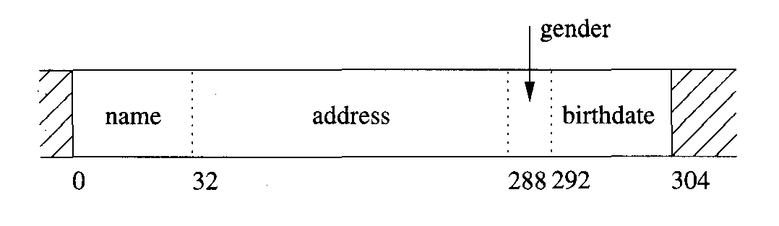
The layout of MovieStar tuples when fields are required to start at multiple of 4 bytes

Slide 26
The Need for a Record Schema
We might wonder why we need to indicate the record schema in the record itself, since currently we are only considering fixed-format records. For example, fields in a “struct,” as used in C or similar languages, do not have their offsets stored when the program is running; rather the offsets are compiled into the application programs that access the struct.
However, there are several reasons why the record schema must be stored and accessible to the DBMS. For one, the schema of a relation (and therefore the schema of the records that represent its tuples) can change. Queries need to use the current schema for these records, and so need to know what the schema currently is. In other situations, we may not be able to tell immediately what the record type is simply from its location in the storage system. For example, some storage organizations permit tuples of different relations to appear in the same block of storage.

Slide 27
Record Headers
There is another issue that must be raised when we design the layout of a record. Often, there is information that must be kept in the record but that is not the value of any field. For example, we may want to keep in the record:
The record schema, or more likely, a pointer to a place where the DBMS stores the schema for this type of record,
The length of the record,
Timestamps indicating the time the record was last modified, or last read,
among other possible pieces of information. Thus, many record layouts include a header of some small number of bytes to provide this additional information.

Slide 28
Record Headers
The database system maintains schema information, which is essentially what appears in the CREATE TABLE statement for that relation:
The attributes of the relation,
Their types,
The order in which attributes appear in the tuple,
Constraints on the attributes and the relation itself, such as primary key declarations, or a constraint that some integer attribute must have a value in a certain range.
We do not have to put all this information in the header of a tuple’s record. It is sufficient to put there a pointer to the place where the information about the tuple’s relation is stored. Then all this information can be obtained when needed.
As another example, even though the length of the tuple may be deducible from its schema, it may be convenient to have the length in the record itself. For instance, we may not wish to examine the record contents, but just find the beginning of the next record quickly. A length field lets us avoid accessing the record’s schema, which may involve a disk I/O.

Slide 29
Example
Let us modify the layout of previous example to include a header of 12 bytes. The first four bytes are the type. It is actually an offset in an area where the schemas for all the relations are kept. The second is the record length, a 4-byte integer, and the third is a timestamp indicating when the tuple was inserted or last updated. The timestamp is also a 4-byte integer. The resulting layout is shown in next figure. The length of the record is now 316 bytes.

Slide 30
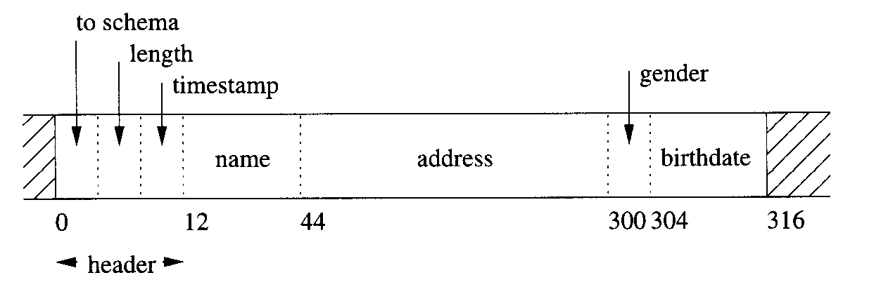
Adding some header information to records representing tuples of the MovieStar relation

Slide 31
Packing Fixed-Length Records into Blocks
Records representing tuples of a relation are stored in blocks of the disk and moved into main memory (along with their entire block) when we need to access or update them. The layout of a block that holds records is suggested in next figure.
There is an optional block header that holds information such as:
Links to one or more other blocks that are part of a network of blocks such as those yet described for creating indexes to the tuples of a relation.
Information about the role played by this block in such a network.
Information about which relation the tuples of this block belong to.
A “directory” giving the offset of each record in the block.
A “block ID”.
Timestamp(s) indicating the time of the block’s last modification and/or access.
By far the simplest case is when the block holds tuples from one relation, and the records for those tuples have a fixed format. In that case, following the header, we pack as many records as we can into the block and leave the remaining space unused.

Slide 32
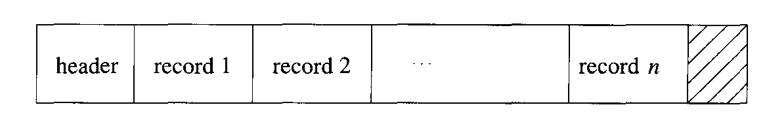
A typical block holding records

Slide 33
Example
Suppose we are storing records with the layout developed in previous example. These records are 316 bytes long. Suppose also that we use 4096-byte blocks. Of these bytes, say 12 will be used for a block header, leaving 4084 bytes for data. In this space we can fit twelve records of the given 316-byte format, and 292 bytes of each block are wasted space.

Slide 34
Representing Block and Record Addresses
Before proceeding with the study of how records with more complex structure are represented, we must consider how addresses, pointers, or references to records and blocks can be represented, since these pointers often form part of complex records. There are other reasons for knowing about secondary- storage address representation as well. When we look at efficient structures for representing files or relations, we shall see several important uses for the address of a block or the address of a record.
The address of a block when it is loaded into a buffer of main memory can be taken to be the virtual-memory address of its first byte, and the address of a record within that block is the virtual-memory address of the first byte of that record. However, in secondary storage, the block is not part of the application’s virtual-memory address space. Rather, a sequence of bytes describes the location of the block within the overall system of data accessible to the DBMS: the device ID for the disk, the cylinder number, and so on. A record can be identified by giving its block and the offset of the first byte of the record within the block.

Slide 35
Representing Block and Record Addresses
To complicate further the matter of representing addresses, a recent trend toward “object brokers” allows independent creation of objects by many cooperating systems. These objects may be represented by records that are part of an object-oriented DBMS, although we can think of them as tuples of relations without losing the principal idea. However, the capability for independent creation of objects or records puts additional stress on the mechanism that maintains addresses of these records.
We shall begin with a discussion of address spaces, especially as they pertain to the common “client-server” architecture for DBMS’s. We then discuss the options for representing addresses, and finally look at “pointer swizzling,” the ways in which we can convert addresses in the data server’s world to the world of the client application programs.

Slide 36
Client-Server Systems
Commonly, a database consists of a server process that provides data from secondary storage to one or more client processes that are applications using the data. The server and client processes may be on one machine, or the server and the various clients can be distributed over many machines.
The client application uses a conventional “virtual” address space, typically 32 bits, or about 4 billion different addresses. The operating system or DBMS decides which parts of the address space are currently located in main memory, and hardware maps the virtual address space to physical locations in main memory. We shall not think further of this virtual-to-physical translation, and shall think of the client address space as if it were main memory itself.

Slide 37
Client-Server Systems
The server’s data lives in a database address space. The addresses of this space refer to blocks, and possibly to offsets within the block. There are several ways that addresses in this address space can be represented:
Physical Addresses. These are byte strings that let us determine the place within the secondary storage system where the block or record can be found. One or more bytes of the physical address are used to indicate each of:
The host to which the storage is attached (if the database is stored across more than one machine),
An identifier for the disk or other device on which the block is located,
The number of the cylinder of the disk,
The number of the track within the cylinder (if the disk has more than one surface),
The number of the block within the track.
(In some cases) the offset of the beginning of the record within the block.
Logical Addresses. Each block or record has a “logical address,” which is an arbitrary string of bytes of some fixed length. A map table, stored on disk in a known location, relates logical to physical addresses, as suggested.

Slide 38
Client-Server Systems
Notice that physical addresses are long. Eight bytes is about the minimum we could use if we incorporate all the listed elements, and some systems use up to 16 bytes. For example, imagine a database of objects that is designed to last for 100 years. In the future, the database may grow to encompass one million machines, and each machine might be fast enough to create one object every nanosecond. This system would create around objects, which requires a minimum of ten bytes to represent addresses. Since we would probably prefer to reserve some bytes to represent the host, others to represent the storage unit, and so on, a rational address notation would use considerably more than 10 bytes for a system of this scale.

Slide 39
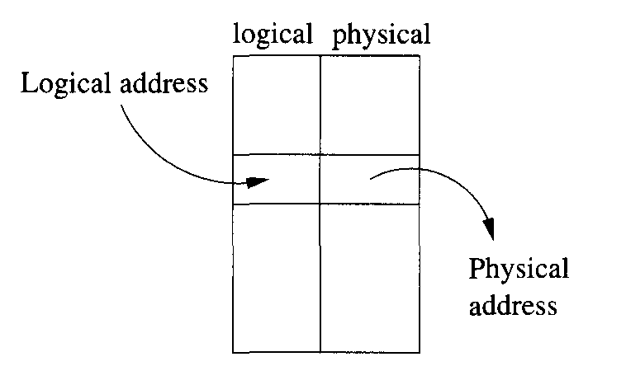
A map table translates logical to physical addresses

Slide 40
Logical and Structured Addresses
One might wonder what the purpose of logical addresses could be. All the information needed for a physical address is found in the map table, and following logical pointers to records requires consulting the map table and then going to the physical address. However, the level of indirection involved in the map table allows us considerable flexibility. For example, many data organizations require us to move records around, either within a block or from block to block. If we use a map table, then all pointers to the record refer to this map table, and all we have to do when we move or delete the record is to change the entry for that record in the table.
Many combinations of logical and physical addresses are possible as well, yielding structured address schemes. For instance, one could use a physical address for the block (but not the offset within the block), and add the key value for the record being referred to. Then, to find a record given this structured address, we use the physical part to reach the block containing that record, and we examine the records of the block to find the one with the proper key.

Slide 41
Logical and Structured Addresses
Of course, to survey the records of the block, we need enough information to locate them. The simplest case is when the records are of a known, fixed- length type, with the key field at a known offset. Then, we only have to find in the block header a count of how many records are in the block, and we know exactly where to find the key fields that might match the key that is part of the address. However, there are many other ways that blocks might be organized so that we could survey the records of the block; we shall cover others shortly.
A similar, and very useful, combination of physical and logical addresses is to keep in each block an offset table that holds the offsets of the records within the block, as suggested. Notice that the table grows from the front end of the block, while the records are placed starting at the end of the block. This strategy is useful when the records need not be of equal length. Then, we do not know in advance how many records the block will hold, and we do not have to allocate a fixed amount of the block header to the table initially.

Slide 42
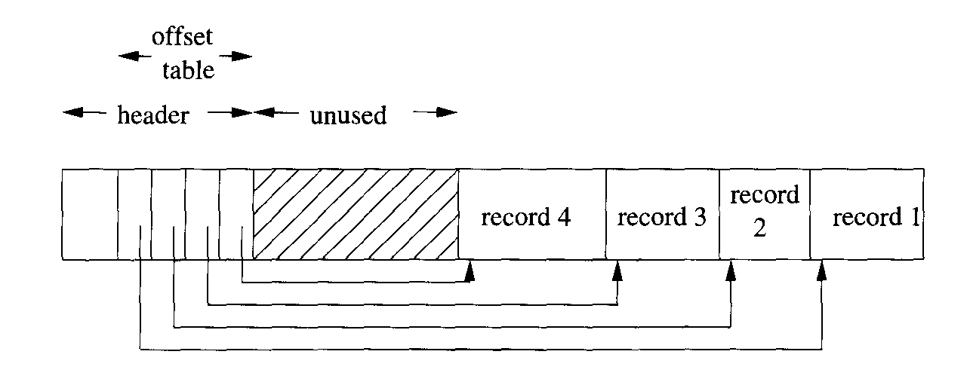
A block with a table of offsets telling us the position of each record within the block

Slide 43
Logical and Structured Addresses
The address of a record is now the physical address of its block plus the offset of the entry in the block’s offset table for that record. This level of indirection within the block offers many of the advantages of logical addresses, without the need for a global map table.
We can move the record around within the block, and all we have to do is change the record’s entry in the offset table; pointers to the record will still be able to find it.
We can even allow the record to move to another block, if the offset table entries are large enough to hold a “forwarding address” for the record.
Finally, we have an option, should the record be deleted, of leaving in its offset-table entry a tombstone, a special value that indicates the record has been deleted. Prior to its deletion, pointers to this record may have been stored at various places in the database. After record deletion, following a pointer to this record leads to the tombstone, whereupon the pointer can either be replaced by a null pointer, or the data structure otherwise modified to reflect the deletion of the record. Had we not left the tombstone, the pointer might lead to some new record, with surprising, and erroneous, results.

Slide 44
Pointer Swizzling
Often, pointers or addresses are part of records. This situation is not typical for records that represent tuples of a relation, but it is common for tuples that represent objects. Also, modern object-relational database systems allow attributes of pointer type (called references), so even relational systems need the ability to represent pointers in tuples. Finally, index structures are composed of blocks that usually have pointers within them. Thus, we need to study the management of pointers as blocks are moved between main and secondary memory; we do so in this section.

Slide 45
Pointer Swizzling
As we mentioned earlier, every block, record, object, or other referenceable data item has two forms of address:
Its address in the server’s database address space, which is typically a sequence of eight or so bytes locating the item in the secondary storage of the system. We shall call this address the database address.
An address in virtual memory (provided that item is currently buffered in virtual memory). These addresses are typically four bytes. We shall refer to such an address as the memory address of the item.
When in secondary storage, we surely must use the database address of the item. However, when the item is in the main memory, we can refer to the item by either its database address or its memory address. It is more efficient to put memory addresses wherever an item has a pointer, because these pointers can be followed using single machine instructions.

Slide 46
Pointer Swizzling
In contrast, following a database address is much more time-consuming. We need a table that translates from all those database addresses that are currently in virtual memory to their current memory address. Such a translation table is suggested. It may be reminiscent of the map table that translates between logical and physical addresses. However:
Logical and physical addresses are both representations for the database address. In contrast, memory addresses in the translation table are for copies of the corresponding object in memory.
All addressable items in the database have entries in the map table, while only those items currently in memory are mentioned in the translation table.

Slide 47
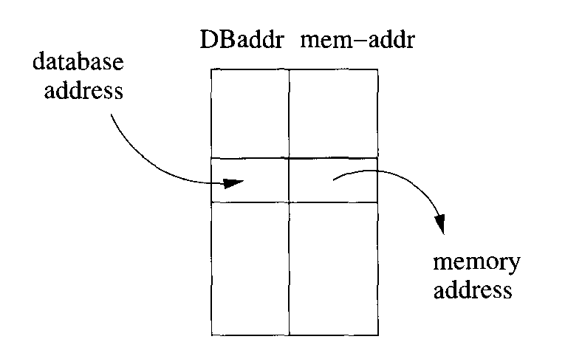
The translation table turns database addresses into their equivalents in memory

Slide 48
Pointer Swizzling
To avoid the cost of translating repeatedly from database addresses to memory addresses, several techniques have been developed that are collectively known as pointer swizzling. The general idea is that when we move a block from secondary to main memory, pointers within the block may be “swizzled,” that is, translated from the database address space to the virtual address space.
Thus, a pointer actually consists of:
A bit indicating whether the pointer is currently a database address or a (swizzled) memory address.
The database or memory pointer, as appropriate. The same space is used for whichever address form is present at the moment. Of course, not all the space may be used when the memory address is present, because it is typically shorter than the database address.
There are several strategies we can use to determine when to swizzle pointers.

Slide 49
Example
Figure shows a simple situation in which the Block 1 has a record with pointers to a second record on the same block and to a record on another block. The figure also shows what might happen when Block 1 is copied to memory. The first pointer, which points within Block 1, can he swizzled so it points directly to the memory address of the target record.
However, if Block 2 is not in memory at this time, then we cannot swizzle the second pointer; it must remain unswizzled, pointing to the database address of its target. Should Block 2 be brought to memory later, it becomes theoretically possible to swizzle the second pointer of Block 1. Depending on the swizzling strategy used, there may or may not be a list of such pointers that are in memory, referring to Block 2; if so, then we have the option of swizzling the pointer at that time.

Slide 50
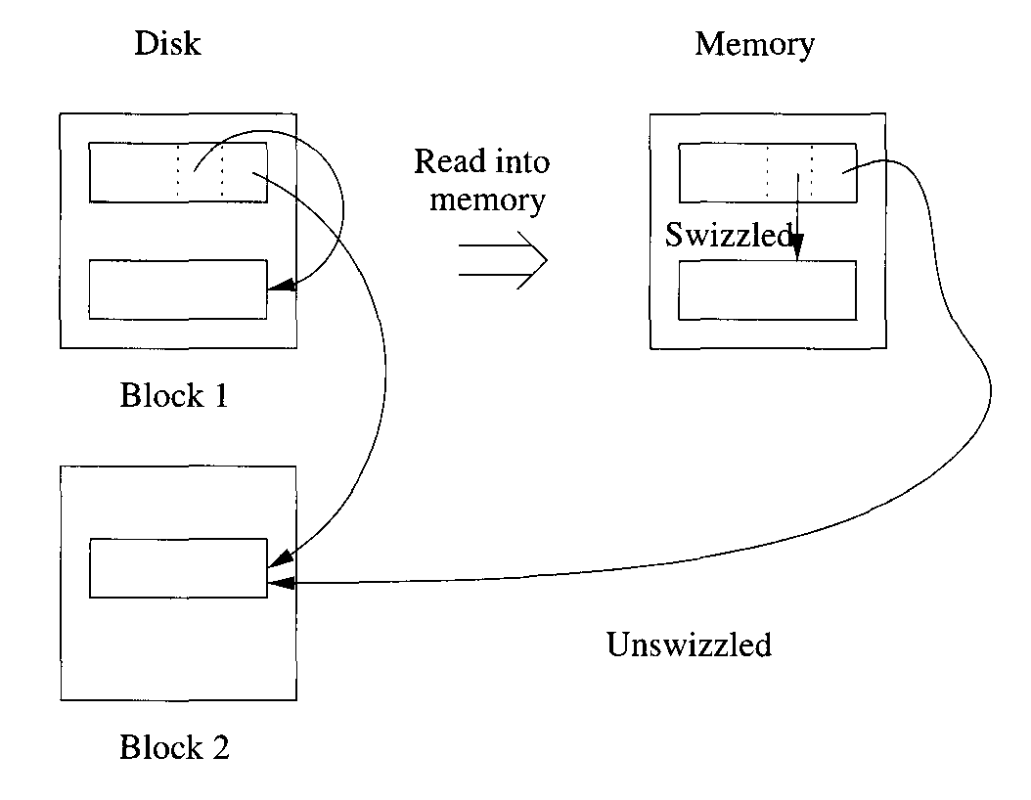
Structure of a pointer when swizzling is used

Slide 51
Automatic Swizzling
As soon as a block is brought into memory, we locate all its pointers and addresses and enter them into the translation table if they are not already there. These pointers include both the pointers from records in the block to elsewhere and the addresses of the block itself and/or its records, if these are addressable items. We need some mechanism to locate the pointers within the block. For example:
If the block holds records with a known schema, the schema will tell us where in the records the pointers are found.
If the block is used for one of the index structures we shall discuss later, then the block will hold pointers at known locations. We may keep within the block header a list of where the pointers are.

Slide 52
Automatic Swizzling
When we enter into the translation table the addresses for the block just moved into memory, and/or its records, we know where in memory the block has been buffered. We may thus create the translation-table entry for these database addresses straightforwardly. When we insert one of these database addresses A into the translation table, we may find it in the table already, because its block is currently in memory. In this case, we replace A in the block just moved to memory by the corresponding memory address, and we set the “swizzled” bit to true. On the other hand, if A is not yet in the translation table, then its block has not been copied into main memory. We therefore cannot swizzle this pointer and leave it in the block as a database pointer.
If we try to follow a pointer P from a block, and we find that pointer P is still unswizzled, i.e., in the form of a database pointer, then we need to make sure the block B containing the item that P points to is in memory (or else why are we following that pointer?). We consult the translation table to see if database address P currently has a memory equivalent. If not, we copy block B into a memory buffer. Once B is in memory, we can “swizzle” P by replacing its database form by the equivalent memory form.

Slide 53
Swizzling on Demand
Another approach is to leave all pointers unswizzled when the block is first brought into memory. We enter its address, and the addresses of its pointers, into the translation table, along with their memory equivalents. If and when we follow a pointer P that is inside sonic block of memory, we swizzle it, using the same strategy that we followed when we found an unswizzled pointer using automatic swizzling.
The difference between on-demand arid automatic swizzling is that the latter tries to get all the pointers swizzled quickly and efficiently when the block is loaded into memory. The possible time saved by swizzling all of a block’s pointers at one time must be weighed against the possibility that some swizzled pointers will never be followed. In that ease, any time spent swizzling and unswizzling the pointer will he wasted.
An interesting option is to arrange that database pointers look like invalid memory addresses. If so, then we can allow the computer to follow any pointer as if it were in its memory form. If the pointer happens to be unswizzled, then the memory reference will cause a hardware trap. If the DBMS provides a function that is invoked by the trap, and this function “swizzles” the pointer in the manner described above, then we can follow swizzled pointers in single instructions, and only need to do something more time consuming when the pointer is unswizzled.

Slide 54
No Swizzling
Of course it is possible never to swizzle pointers. We still need the translation table. so the pointers may he followed in their unswizzled form. This approach does offer the advantage that records cannot be pinned in memory, as discussed and decisions about which form of pointer is present need he made.

Slide 55
Programmer Control of Swizzling
In some applications, it may he known by the application programmer whether the pointers in a block are likely to be followed. This programmer may be able to specify explicitly that a block loaded into memory is to have its pointers swizzled, or the programmer may call for the pointers to be swizzled only as needed. For example, if a programmer knows that a block is likely to he accessed heavily, such as the root block of a B-tree, then the pointers would be swizzled. However, blocks that are loaded into memory, used once, and then likely dropped from memory, would not be swizzled.

Slide 56
Returning Blocks to Disk
When a block is moved from memory back to disk, any pointers within that block must be “unswizzled”; that is, their memory addresses must be replaced by the corresponding database addresses. The translation table can be used to associate addresses of the two types in either direction, so in principle it is possible to find, given a memory address, the database address to which the memory address is assigned.
However, we do not want each unswizzling operation to require a search of the entire translation table. While we have not discussed the implementation of this table, we might imagine that the table of next figure has appropriate indexes. If we think of the translation table as a relation, then the problem of finding the memory address associated with a database address x can be expressed as the query:
SELECT memAddr
FROM TranslationTable
WHERE dbAddr = x;

Slide 57
Returning Blocks to Disk
For instance, a hash table using the database address as the key might be appropriate for an index on the dbAddr attribute; later we suggest many possible data structures.
If we want to support the reverse query,
SELECT dbAddr
FROM TranslationTable
WHERE memAddr = y;
then we need to have an index on attribute memAddr as well. Again, later we suggest data structures suitable for such an index. Also, later we talk about linked-list structures that in some circumstances can be used to go from a memory address to all main-memory pointers to that address.

Slide 58
Pinned Records and Blocks
A block in memory is said to be pinned if it cannot at the moment be written back to disk safely. A bit telling whether or not a block is pinned can be located in the header of the block. There are many reasons why a block could be pinned, including requirements of a recovery system as discussed later. Pointer swizzling introduces an important reason why certain blocks must be pinned.
If a block B1 has within it a swizzled pointer to some data item in block B2, then we must be very careful about moving block B2 back to disk and reusing its main-memory buffer. The reason is that, should we follow the pointer in B1, it will lead us to the buffer, which no longer holds B2 in effect, the pointer has become dangling. A block, like B2, that is referred to by a swizzled pointer from somewhere else is therefore pinned.

Slide 59
Pinned Records and Blocks
When we write a block back to disk, we not only need to “unswizzle” any pointers in that block. We also need to make sure it is not pinned. If it is pinned, we must either unpin it, or let the block remain in memory, occupying space that could otherwise be used for some other block. To unpin a block that is pinned because of swizzled pointers from outside, we must “unswizzle” any pointers to it. Consequently, the translation table must record, for each database address whose data item is in memory, the places in memory where swizzled pointers to that item exist. Two possible approaches are:
Keep the list of references to a memory address as a linked list attached to the entry for that address in the translation table.
If memory addresses are significantly shorter than database addresses, we can create the linked list in the space used for the pointers themselves.
That is, each space used for a database pointer is replaced by
The swizzled pointer, and
Another pointer that forms part of a linked list of all occurrences of this pointer.
Next figure suggests how all the occurrences of a memory pointer y could be linked, starting at the entry in the translation table for database address x and its corresponding memory address y.

Slide 60
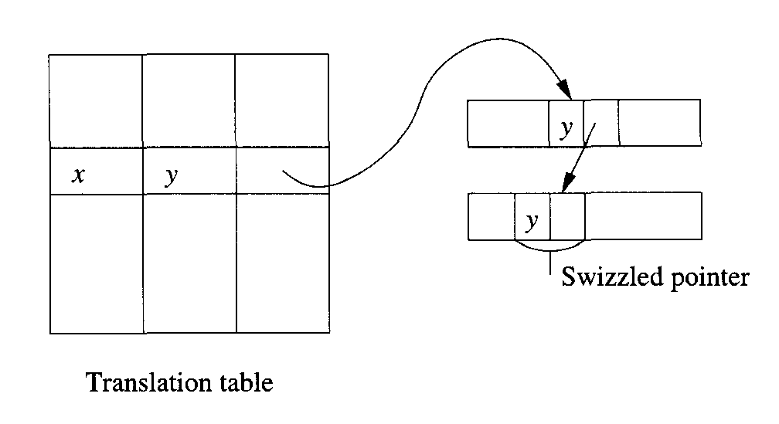
A linked list of occurrences of a swizzled pointer

Slide 61
Variable-Length Data and Records
Until now, we have made the simplifying assumptions that every data item has a fixed length, that records have a fixed schema, and that the schema is a list of fixed-length fields. However, in practice, life is rarely so simple. We may wish to represent:
Data items whose size varies. For instance, we considered a MovieStar relation that had an address field of up to 255 bytes. While there might be some addresses that long, the vast majority of them will probably be 50 bytes or less. We could probably save more than half the space used for storing MovieStar tuples if we used only as much space as the actual address needed.
Repeating fields. If we try to represent a many-many relationship in a record representing an object, we shall have to store references to as many objects as are related to the given object.

Slide 62
Variable-Length Data and Records
Variable-format records. Sometimes we do not know in advance what the fields of a record will be, or how many occurrences of each field there will be. For example, some movie stars also direct movies, and we might want to add fields to their record referring to the movies they directed. Likewise, some stars produce movies or participate in other ways, and we might wish to put this information into their record as well. However, since most stars are neither producers nor directors, we would not want to reserve space for this information in every star’s record.
Enormous fields. Modern DBMS’s support attributes whose value is a very large data item. For instance, we might want to include a picture attribute with a movie-star record that is a GIF image of the star. A movie record might have a field that is a 2-gigabyte MPEG encoding of the movie itself, as well as more mundane fields such as the title of the movie. These fields are so large, that our intuition that records fit within blocks is contradicted.

Slide 63
Records With Variable-Length Fields
If one or more fields of a record have variable length, then the record must contain enough information to let us find any field of the record. A simple but effective scheme is to put all fixed-length fields ahead of the variable-length fields. We then place in the record header:
The length of the record.
Pointers to (i.e., offsets of) the beginnings of all the variable-length fields. However, if the variable-length fields always appear in the same order, then the first of them needs no pointer; we know it immediately follows the fixed-length fields.

Slide 64
Example
Suppose that we have movie-star records with name, address, gender, and birthdate. We shall assume that the gender and birthdate are fixed-length fields, taking 4 and 12 bytes, respectively. However, both name and address will be represented by character strings of whatever length is appropriate. Next figure suggests what a typical movie-star record would look like. We shall always put the name before the address. Thus, no pointer to the beginning of the name is needed; that field will always begin right after the fixed-length portion of the record.

Slide 65
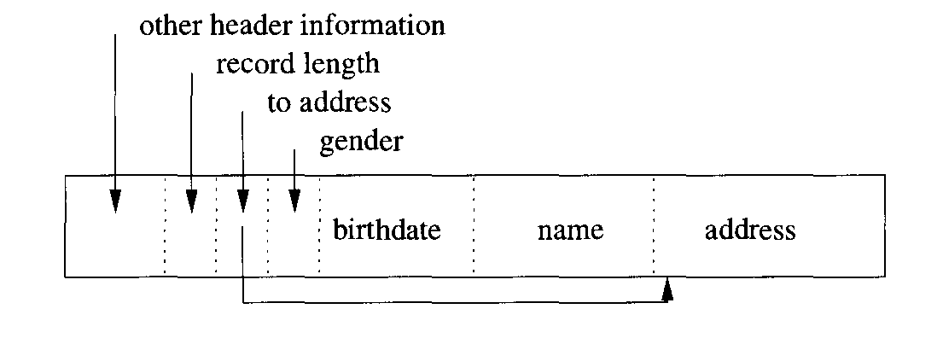
A MovieStar record with name and address implemented as variable-length character strings

Slide 66
Records With Repeating Fields
A similar situation occurs if a record contains a variable number of occurrences of a field F, but the field itself is of fixed length. It is sufficient to group all occurrences of field F together and put in the record header a pointer to the first. We can locate all the occurrences of the field F as follows. Let the number of bytes devoted to one instance of field F be L. We then add to the offset for the field F all integer multiples of L, starting at 0, then L, 2L, 3L, and so on. Eventually, we reach the offset of the field following F, whereupon we stop.

Slide 67
Example
Suppose that we redesign our movie-star records to hold only the name and address (which are variable-length strings) and pointers to all the movies of the star. Next figure shows how this type of record could be represented. The header contains pointers to the beginning of the address field (we assume the name field always begins right after the header) and to the first of the movie pointers. The length of the record tells us how many movie pointers there are.

Slide 68
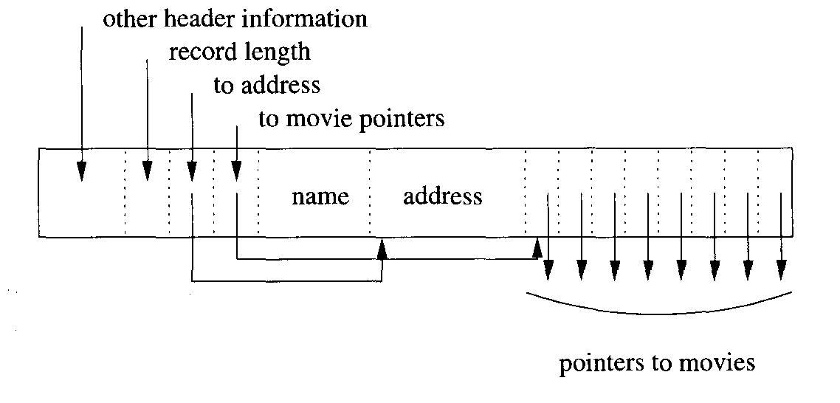
A record with a repeating group of references to movies

Slide 69
Records With Repeating Fields
An alternative representation is to keep the record of fixed length, and put the variable-length portion be it fields of variable length or fields that repeat an indefinite number of times on a separate block. In the record itself we keep:
Pointers to the place where each repeating field begins, and
Either how many repetitions there are, or where the repetitions end.
Next figure shows the layout of a record for the problem of previous example, but with the variable-length fields name and address, and the repeating field starredln (a set of movie references) kept on a separate block or blocks.

Slide 70
Records With Repeating Fields
There are advantages and disadvantages to using indirection for the variable-length components of a record:
Keeping the record itself fixed-length allows records to be searched more efficiently, minimizes the overhead in block headers, and allows records to be moved within or among blocks with minimum effort.
On the other hand, storing variable-length components on another block increases the number of disk I/O’s needed to examine all components of a record.

Slide 71
Records With Repeating Fields
A compromise strategy is to keep in the fixed-length portion of the record enough space for:
Some reasonable number of occurrences of the repeating fields,
A pointer to a place where additional occurrences could be found, and
A count of how many additional occurrences there are.
If there are fewer than this number, some of the space would be unused. If there are more than can fit in the fixed-length portion, then the pointer to additional space will be nonnull, and we can find the additional occurrences by following this pointer.

Slide 72
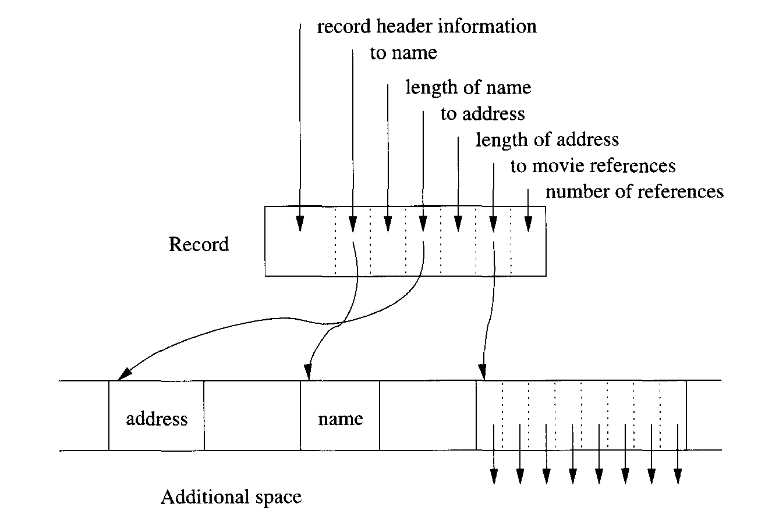
Storing variable-length fields separately from the record

Slide 73
Representing Null Values
Tuples often have fields that may be NULL. The record format offers a convenient way to represent NULL values. If a field such as address is null, then we put a null pointer in the place where the pointer to an address goes. Then, we need no space for an address, except the place for the pointer. This arrangement can save space on average, even if address is a fixed-length field but frequently has the value NULL.

Slide 74
Variable-Format Records
An even more complex situation occurs when records do not have a fixed schema. That is, the fields or their order are not completely determined by the relation or class whose tuple or object the record represents. The simplest representation of variable-format records is a sequence of tagged fields, each of which consists of:
Information about the role of this field, such as:
The attribute or field name,
The type of the field, if it is not apparent from the field name and some readily available schema information, and
The length of the field, if it is not apparent from the type.
The value of the field.

Slide 75
Variable-Format Records
There are at least two reasons why tagged fields would make sense.
Information-integration applications. Sometimes, a relation has been constructed from several earlier sources, and these sources have different kinds of information. For instance, our Moviestar information may have come from several sources, one of which records birthdates and the others do not, some give addresses, others not, and so on. If there are not too many fields, we are probably best off leaving NULL those values we do not know. However, if there are many sources, with many different kinds of information, then there may be too many NULL’s, and we can save significant space by tagging and listing only the nonnull fields.
Records with a very flexible schema. If many fields of a record can repeat and/or not appear at all, then even if we know the schema, tagged fields may be useful. For instance, medical records may contain information about many tests, but there are thousands of possible tests, and each patient has results for relatively few of them.

Slide 76
Example
Suppose some movie stars have information such as movies directed, former spouses, restaurants owned, and a number of other fixed but unusual pieces of information. In next figure we see the beginning of a hypothetical movie-star record using tagged fields. We suppose that single-byte codes are used for the various possible field names and types. Appropriate codes are indicated on the figure, along with lengths for the two fields shown, both of which happen to be of type string.

Slide 77
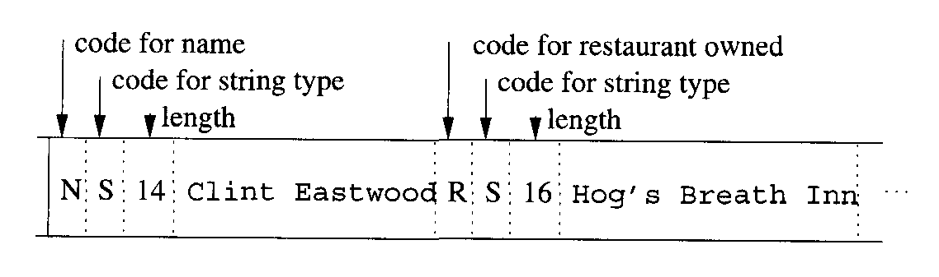
A record with tagged fields

Slide 78
Records That Do Not Fit in a Block
We shall now address another problem whose importance has been increasing as DBMS’s are more frequently used to manage datatypes with large values: often values do not fit in one block. Typical examples are video or audio “clips.” Often, these large values have a variable length, but even if the length is fixed for all values of the type, we need to use some special techniques to represent these values. In this section we shall consider a technique called “spanned records” that can be used to manage records that are larger than blocks. The management of extremely large values (megabytes or gigabytes) is addressed later.
Spanned records also are useful in situations where records are smaller than blocks, but packing whole records into blocks wastes significant amounts of space. For instance, the waste space in previous example was only 7%, but if records are just slightly larger than half a block, the wasted space can approach 50%. The reason is that then we can pack only one record per block.

Slide 79
Records That Do Not Fit in a Block
For both these reasons, it is sometimes desirable to allow records to be split across two or more blocks. The portion of a record that appears in one block is called a record fragment. A record with two or more fragments is called spanned, and records that do not cross a block boundary are unspanned.
If records can be spanned, then every record and record fragment requires some extra header information:
Each record or fragment header must contain a bit telling whether or not it is a fragment.
If it is a fragment, then it needs bits telling whether it is the first or last fragment for its record.
If there is a next and/or previous fragment for the same record, then the fragment needs pointers to these other fragments.

Slide 80
Example
Next figure suggests how records that were about 60% of a block in size could be stored with three records for every two blocks. The header for record fragment 2a contains an indicator that it is a fragment, an indicator that it is the first fragment for its record, and a pointer to next fragment, 2b. Similarly, the header for 2b indicates it is the last fragment for its record and holds a back-pointer to the previous fragment 2a.

Slide 81
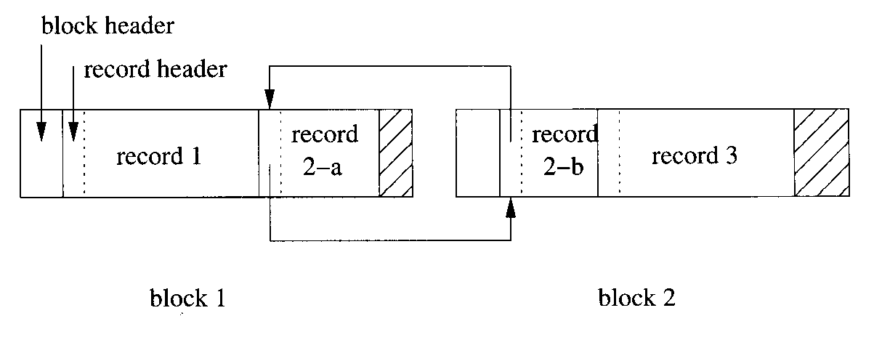
Storing spanned records across blocks

Slide 82
BLOBS
Now, let us consider the representation of truly large values for records or fields of records. The common examples include images in various formats (e.g., GIF, or JPEG), movies in formats such as MPEG, or signals of all sorts: audio, radar, and so on. Such values are often called binary, large objects, or BLOBS. When a field has a BLOB as value, we must rethink at least two issues.

Slide 83
Storage of BLOBS
A BLOB must be stored on a sequence of blocks. Often we prefer that these blocks are allocated consecutively on a cylinder or cylinders of the disk, so the BLOB may be retrieved efficiently. However, it is also possible to store the BLOB on a linked list of blocks.
Moreover, it is possible that the BLOB needs to be retrieved so quickly (e.g., a movie that must be played in real time), that storing it on one disk does not allow us to retrieve it fast enough. Then, it is necessary to stripe the BLOB across several disks, that is, to alternate blocks of the BLOB among these disks. Thus, several blocks of the BLOB can be retrieved simultaneously, increasing the retrieval rate by a factor approximately equal to the number of disks involved in the striping.

Slide 84
Retrieval of BLOBS
Our assumption that when a client wants a record, the block containing the record is passed from the database server to the client in its entirety may not hold. We may want to pass only the “small” fields of the record, and allow the client to request blocks of the BLOB one at a time, independently of the rest of the record. For instance, if the BLOB is a 2-hour movie, and the client requests that the movie be played, the BLOB could be shipped several blocks at a time to the client, at just the rate necessary to play the movie.
In many applications, it is also important that the client be able to request interior portions of the BLOB without having to receive the entire BLOB. Examples would be a request to see the 45th minute of a movie, or the ending of an audio clip. If the DBMS is to support such operations, then it requires a suitable index structure, e.g., an index by seconds on a movie BLOB.

Slide 85
Record Modifications
Insertions, deletions, and update of records often create special problems. These problems are most severe when the records change their length, but they come up even when records and fields are all of fixed length.

Slide 86
Insertion
First, let us consider insertion of new records into a relation (or equivalently, into the current extent of a class). If the records of a relation are kept in no particular order, we can just find a block with some empty space, or get a new block if there is none, and put the record there. Usually, there is some mechanism for finding all the blocks holding tuples of a given relation or objects of a class, but we shall discuss later the question of how to keep track of these blocks.
There is more of a problem when the tuples must be kept in some fixed order, such as sorted by their primary key. There is good reason to keep records sorted, since it facilitates answering certain kinds of queries. If we need to insert a new record, we first locate the appropriate block for that record. Fortuitously, there may be space in the block to put the new record. Since records must be kept in order, we may have to slide records around in the block to make space available at the proper point.

Slide 87
Insertion
If we need to slide records, then the block organization that we showed, which we reproduce here in next figure, is useful. Recall from our discussion that we may create an “offset table” in the header of each block, with pointers to the location of each record in the block. A pointer to a record from outside the block is a “structured address,” that is, the block address and the location of the entry for the record in the offset table.
If we can find room for the inserted record in the block at hand, then we simply slide the records within the block and adjust the pointers in the offset table. The new record is inserted into the block, and a new pointer to the record is added to the offset table for the block.

Slide 88
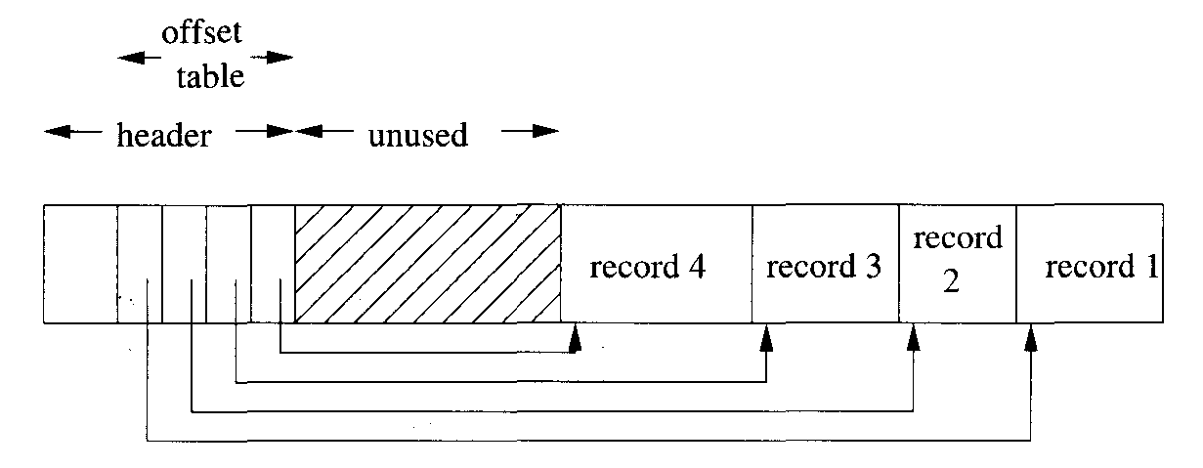
An offset table lets us slide records within a block to make room for new records

Slide 89
Insertion
However, there may be no room in the block for the new record, in which case we have to find room outside the block. There are two major approaches to solving this problem, as well as combinations of these approaches.
Find space on a “nearby” block. For example, if block B1 has no available space for a record that needs to be inserted in sorted order into that block, then look at the following block B2 in the sorted order of the blocks. If there is room in B2, move the highest record(s) of B1 to B2, and slide the records around on both blocks. However, if there are external pointers to records, then we have to be careful to leave a forwarding address in the offset table of B1 to say that a certain record has been moved to B2 and where its entry in the offset table of B2 is. Allowing forwarding addresses typically increases the amount of space needed for entries of the offset table.
Create an overflow block. In this scheme, each block B has in its header a place for a pointer to an overflow block where additional records that theoretically belong in B can be placed. The overflow block for B can point to a second overflow block, and so on. Next figure suggests the structure. We show the pointer for overflow blocks as a nub on the block, although it is in fact part of the block header.

Slide 90
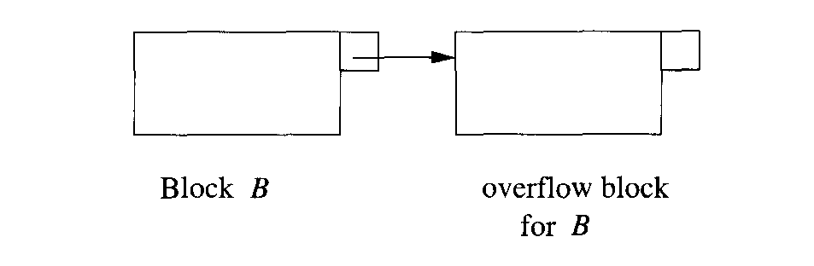
A block and its first overflow block

Slide 91
Deletion
When we delete a record, we may be able to reclaim its space. If we use an offset table and records can slide around the block, then we can compact the space in the block so there is always one unused region in the center, as suggested by that figure.
If we cannot slide records, we should maintain an available-space list in the block header. Then we shall know where, and how large, the available regions are, when a new record is inserted into the block. Note that the block header normally does not need to hold the entire available space list. It is sufficient to put the list head in the block header, and use the available regions themselves to hold the links in the list, much as we did.
When a record is deleted, we may be able to do away with an overflow block. If the record is deleted either from a block B or from any block on its overflow chain, we can consider the total amount of used space on all the blocks of that chain. If the records can fit on fewer blocks, and we can safely move records among blocks of the chain, then a reorganization of the entire chain can he performed.
However, there is one additional complication involved in deletion, which we must remember regardless of what scheme we use for reorganizing blocks. There may be pointers to the deleted record, and if so, we don’t want these pointers to dangle or wind up pointing to a new record that is put in the place of the deleted record. The usual technique, which we pointed out, is to place a tombstone in place of the record. This tombstone is permanent; it must exist until the entire database is reconstructed.

Slide 92
Deletion
Where the tombstone is placed depends on the nature of record pointers. If pointers go to fixed locations from which the location of the record is found, then we put the tombstone in that fixed location. Here are two examples:
We suggested that if the offset-table scheme were used, then the tombstone could be a null pointer in the offset table, since pointers to the record were really pointers to the offset table entries.
If we are using a map table to translate logical record addresses to physical addresses, then the tombstone can be a null pointer in place of the physical address.
If we need to replace records by tombstones, it would be wise to have at the very beginning of the record header a bit that serves as a tombstone; i.e., it is 0 if the record is not deleted, while 1 means that the record has been deleted. Then, only this bit must remain where the record used to begin, and subsequent bytes can be reused for another record, as suggested. (However, the field-alignment problem discussed may force us to leave four bytes or more unused. ) When we follow a pointer to the deleted record, the first thing we see is the “tombstone” bit telling us that the record was deleted. We then know not to look at the following bytes.

Slide 93
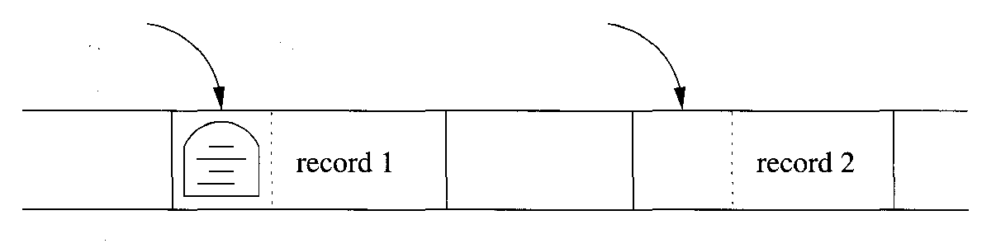
Record 1 can be replaced, but the tombstone remains; record 2 has no tombstone and can be seen when we follow a pointer to it

Slide 94
Update
When a fixed-length record is updated, there is no effect on the storage system, because we know it can occupy exactly the same space it did before the update. However, when a variable-length record is updated, we have all the problems associated with both insertion and deletion, except that it is never necessary to create a tombstone for the old version of the record.
If the updated record is longer than the old version, then we may need to create more space on its block. This process may involve sliding records or even the creation of an overflow block. If variable-length portions of the record are stored on another block then we may need to move elements around that block or create a new block for storing variable-length fields. Conversely, if the record shrinks because of the update, we have the same opportunities as with a deletion to recover or consolidate space, or to eliminate overflow blocks.

Slide 95
Summary
Fields: Fields are the most primitive data elements. Many, such as integers or fixed-length character strings, are simply given an appropriate number of bytes in secondary storage. Variable-length character strings are stored either in a fixed sequence of bytes containing an end marker, or in an area for varying strings, with a length indicated by an integer at the beginning or an end marker at the end.
Records: Records are composed of several fields plus a record header. The header contains information about the record, possibly including such matters as a timestamp, schema information, and a record length.
Variable-Length Records: If records contain one or more variable-length fields or contain an unknown number of repetitions of a field, then additional structure is necessary. A directory of pointers in the record header can be used to locate variable-length fields within the record. Alternatively, we can replace the variable-length or repeating fields by (fixed-length) pointers to a place outside the record where the field’s value is kept.

Slide 96
Summary
Blocks: Records are generally stored within blocks. A block header, with information about that block, consumes some of the space in the block, with the remainder occupied by one or more records.
Spanned Records: Generally, a record exists within one block. However, if records are longer than blocks, or we wish to make use of leftover space within blocks, then we can break records into two or more fragments, one on each block. A fragment header is then needed to link the fragments of a record.
BLOBS: Very large values, such as images and videos, are called BLOBS (binary, large objects). These values must be stored across many blocks. Depending on the requirements for access, it may be desirable to keep the BLOB on one cylinder, to reduce the access time for the BLOB, or it may be necessary to stripe the BLOB across several disks, to allow parallel retrieval of its contents.
Offset Tables: To support insertions and deletions of records, as well as records that change their length due to modification of varying-length fields, we can put in the block header an offset table that has pointers to each of the records in the block.

Slide 97
Summary
Overflow Blocks: Also to support insertions and growing records, a block may have a link to an overflow block or chain of blocks, wherein are kept some records that logically belong in the first block.
Database Addresses: Data managed by a DBMS is found among several storage devices, typically disks. To locate blocks and records in this storage system, we can use physical addresses, which are a description of the device number, cylinder, track, sector(s), and possibly byte within a sector. We can also use logical addresses, which are arbitrary character strings that are translated into physical addresses by a map table.
Structured Addresses: We may also locate records by using part of the physical address, e.g., the location of the block whereon a record is found, plus additional information such as a key for the record or a position in the offset table of a block that locates the record.

Slide 98
Summary
Pointer Swizzling: When disk blocks are brought to main memory, the database addresses need to be translated to memory addresses, if pointers are to be followed. The translation is called swizzling, and can either be done automatically, when blocks are brought to memory, or on-demand, when a pointer is first followed.
Tombstones: When a record is deleted, pointers to it will dangle. A tombstone in place of (part of) the deleted record warns the system that the record is no longer there.
Pinned Blocks: For various reasons, including the fact that a block may contain swizzled pointers, it may be unacceptable to copy a block from memory back to its place on disk. Such a block is said to be pinned. If the pinning is due to swizzled pointers, then they must be unswizzled before returning the block to disk.

